Slide 1
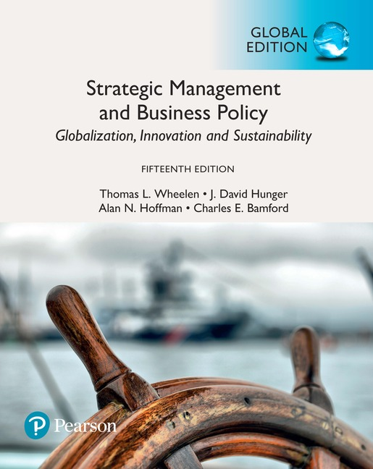
Strategic Management and
Business Policy 15e, Global Edition
Chapter 5
Organizational
Analysis and
Competitive
Advantage

Slide 2
Learning Objectives (1 of 2)
5-1 Apply the resource-based view of the firm and the VRIO framework to determine core and distinctive competencies
5-2 Understand a company business models and how they can be imitated
5-3 Use value chain to assess the activities of
an industry and of an organization
Notes:
After reading this chapter, you should be able to:
Apply the resource-based view of the firm to determine core and distinctive competencies
Use the VRIO framework and the value chain to assess an organization’s competitive advantage and how it can be sustained
Understand a company’s business model and how it could be imitated

Slide 3
Learning Objectives (2 of 2)
5-4 Explain why different organizational structures are utilized in business
5-5 Assess a company’s corporate culture and how it might affect a proposed strategy
5-6 Construct an IFAS Table that summarizes internal factors
Notes:
After reading this chapter, you should be able to:
Assess a company’s corporate culture and how it might affect a proposed strategy
Scan functional resources to determine their fit with a firm’s strategy
Construct an IFAS Table that summarizes internal factors

Slide 4
A Resource-Based Approach to Organizational Analysis
Organizational analysis
  concerned with identifying and developing an organization’s resources and competencies
Notes:
Organizational analysis is concerned with identifying, developing, and taking advantage of an organization’s resources and competencies.

Slide 5
Core and Distinctive Competencies (1 of 5)
Resources
  An organization’s assets and are thus the basic building blocks of the organization.
  Tangible, intangible
Capabilities
  Refer to a corporation’s ability to exploit its resources.
  Consist of business processes and routines that manage the interaction among resources to turn inputs into outputs
Notes:
Resources are an organization’s assets and are thus the basic building blocks of the organization. They include tangible assets (such as its plant, equipment, finances, and location),
human assets (the number of employees, their skills, and motivation), and intangible assets (such as its technology [patents and copyrights], culture, and reputation.
Capabilities refer to a corporation’s ability to exploit its resources. They consist of business processes and routines that manage the interaction among resources to turn inputs into outputs.

Slide 6
Core and Distinctive Competencies (2 of 5)
Core competency
  a collection of competencies that cross divisional boundaries, is wide-spread throughout the corporation and is something the corporation does exceedingly well
Distinctive competency
  core competencies that are superior to those of the competition
Notes:
A core competency is a collection of competencies that crosses divisional boundaries, is widespread within the corporation, and is something that the corporation can do exceedingly well. When core competencies are superior to those of the competition, they are called distinctive competencies.

Slide 7
VRIO Framework of Analysis
Valuable: Does it provide customer value and competitive advantage?
Rareness: Do no other competitors possess it at the same level?
Imitability: Do the competitors have the financial ability to imitate?
Organization: Is the firm organized to exploit the resource?
Notes:
Barney, in his VRIO framework of analysis, proposes four questions to evaluate a firm’s competencies:
1. Value: Does it provide customer value and competitive advantage?
2. Rareness: Do no other competitors possess it?
3. Imitability: Is it costly for others to imitate?
4. Organization: Is the firm organized to exploit the resource?

Slide 8
Core and Distinctive Competencies (3 of 5)
Imitability
  the rate at which a firm’s underlying resources, capabilities, or core competencies can be duplicated by others
Notes:
Imitability is the rate at which a firm’s underlying resources, capabilities, or core competencies can be duplicated by others.

Slide 9
Core and Distinctive Competencies (4 of 5)
Transparency
  the speed at which other firms under the relationship of resources and capabilities support a successful strategy
Transferability
  the ability of competitors to gather the resources and capabilities necessary to support a competitive challenge
Replicability
  the ability of competitors to use duplicated resources and capabilities to imitate the other firm’s success
Notes:
Transparency is the speed with which other firms can understand the relationship of resources and capabilities supporting a successful firm’s strategy.
Transferability is the ability of competitors to gather the resources and capabilities necessary to support a competitive challenge.
Replicability is the ability of competitors to use duplicated resources and capabilities toimitate the other firm’s success.

Slide 10
Core and Distinctive Competencies (5 of 5)
Explicit knowledge
  knowledge that can be easily articulated and communicated
Tacit knowledge
  knowledge that is not easily communicated because it is deeply rooted in employee experience or in the company’s culture
Notes:
It is relatively easy to learn and imitate another company’s core competency or capability if it comes from explicit knowledge—that is, knowledge that can be easily articulated and communicated.
Tacit knowledge, in contrast, is knowledge that is not easily communicated because it is deeply rooted in employee experience or in a corporation’s culture.

Slide 11
Business Models (1 of 4)
Business model
  a company’s method for making money in the current business environment
  includes the key structural and operational characteristics of a firm—how it earns revenue and makes a profit
Notes:
A business model is a company’s method for making money in the current business environment. It includes the key structural and operational characteristics of a firm—how it earns revenue and makes a profit.

Slide 12
Business Models (2 of 4)
A business model is usually composed of five elements:
Who it serves
What it provides
How it makes money
How it differentiates and sustains competitive advantage
How it provides its product/service
Notes:
A business model is usually composed of five elements:
Who it serves
What it provides
How it makes money
How it differentiates and sustains competitive advantage
How it provides its product/service

Slide 13
Business Models (3 of 4)
Some of the many possible business models are:
Customer solutions model
Profit pyramid model
Multi-component system/installed base model
Advertising model
Switchboard model
Notes:
Some of the many possible business models are:
Customer solutions model
Profit pyramid model
Multi-component system/installed model
Advertising model
Switchboard model

Slide 14
Business Models (4 of 4)
Some other possible business models are:
Time model
Efficiency model
Blockbuster model
Profit multiplier model
Entrepreneurial model
De facto industry standard model
Notes:
Some other possible business models are:
Efficiency model
Blockbuster model
Profit multiplier model
Entrepreneurial model
De facto industry standard model

Slide 15
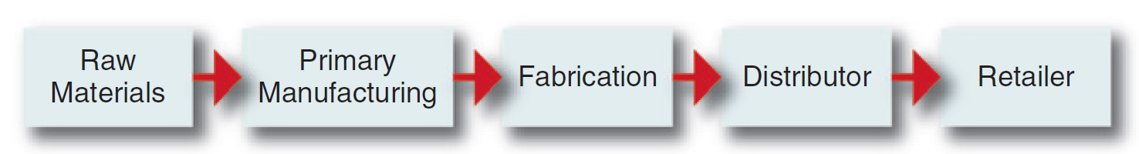
Value-Chain Analysis
Value chain
  a linked set of value-creating activities that begin with basic raw materials coming from suppliers moving on to a series of value-added activities involved in producing and marketing a product or service, and ending with distributors getting the final goods into the hands of the ultimate consumer.
Figure 5-1: Typical Value Chain for a Manufactured Product
Notes:
A value chain is a linked set of value-creating activities that begin with basic raw materials coming from suppliers, moving on to a series of value-added activities involved in producing and marketing a product or service, and ending with distributors getting the final goods into the hands of the ultimate consumer. See Figure 5–1 for an example of a typical value chain for a manufactured product.

Slide 16
Industry Value Chain Analysis
Value chain segments include:
Upstream
Downstream
Center of gravity
  the part of the chain that is most important to the company and the point where its core competencies lie
Notes:
The value chains of most industries can be split into two segments, upstream and downstream. A company’s center of gravity is the part of the chain where the company’s greatest
expertise and capabilities lie—its core competencies.

Slide 17
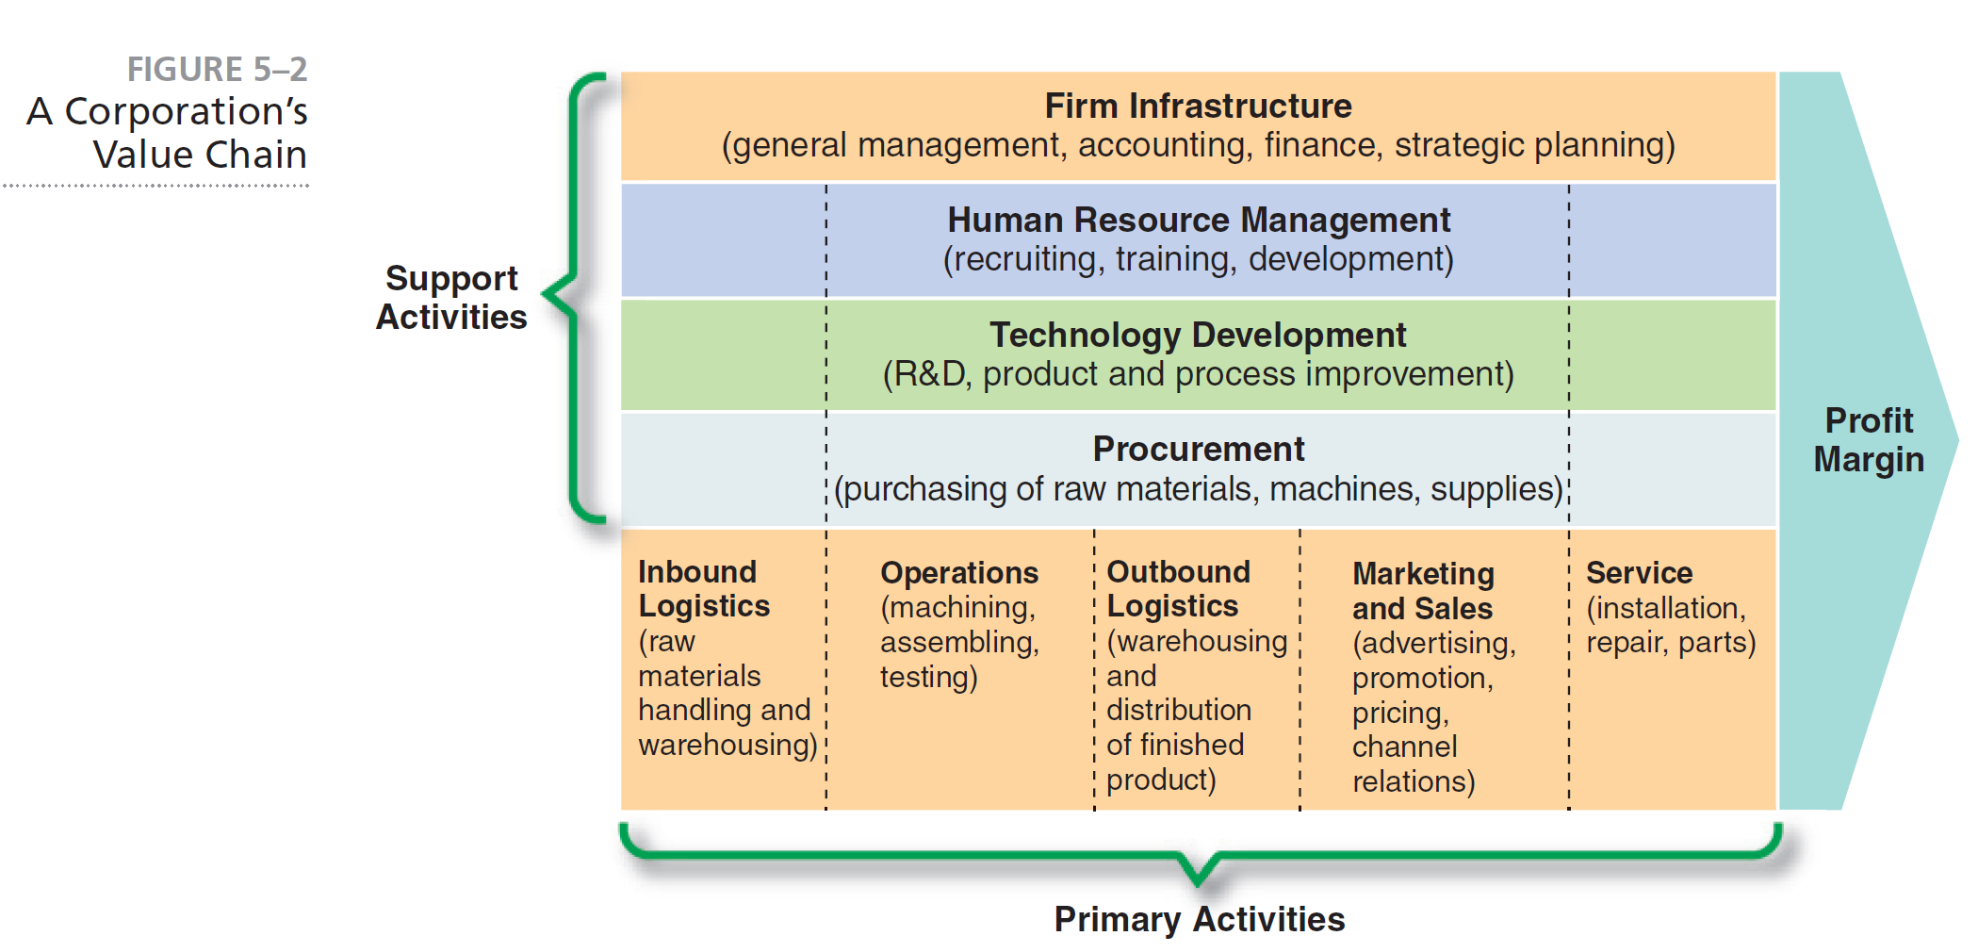
A Corporation’s Value Chain
Notes:
Each corporation has its own internal value chain of activities. See Figure 5–2 for an example of a corporate value chain.

Slide 18
Corporate Value Chain Analysis
(1 of 2)
Primary Activities
Support Activities
Inbound logistics
Operations
Outbound logistics
Procurement
Technology development
Human resource management
Firm infrastructure
Notes:
Porter proposes that a manufacturing firm’s primary activities usually begin with inbound logistics (raw materials handling and warehousing), go through an operations process in which a product is manufactured, and continue to outbound logistics (warehousing and distribution), to marketing and sales, and finally to service (installation, repair, and sale of parts). Several support activities, such as procurement (purchasing), technology development (R&D), human resource management, and firm infrastructure (accounting, finance, strategic planning), ensure that the primary value-chain activities operate effectively and efficiently.

Slide 19
Corporate Value Chain Analysis
(2 of 2)
Examine each product line’s value chain in terms of the various activities involved in producing the product or service
Examine the linkages within each product line’s value chain
Examine the potential synergies among the value chains of different product lines or business units
Notes:
Corporate value-chain analysis involves the following three steps:
Examine each product line’s value chain in terms of the various activities involved in producing the product or service
Examine the linkages within each product line’s value chain
Examine the potential synergies among the value chains of different product lines or business units

Slide 20
Basic Organizational Structures
(1 of 2)
Simple
Functional
Divisional
Strategic business units
Conglomerate
Notes:
Examples of basic organizational structures are simple, functional, divisional, strategic business units, and conglomerate.

Slide 21
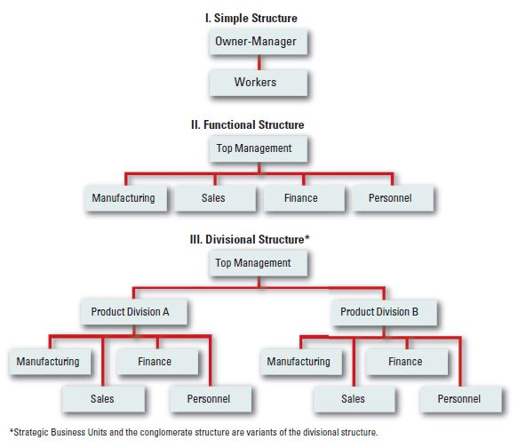
Figure 5-3: Basic Organizational Structures (2 of 2)
Notes:
Figure 5–3 illustrates three basic organizational structures. The conglomerate structure is a variant of divisional structure and is thus not depicted as a fourth structure.

Slide 22
Culture (1 of 2)
Corporate culture
  the collection of beliefs, expectations, and values learned and shared by a corporation’s members and transmitted from one generation of employees to another
Notes:
Corporate culture is the collection of beliefs, expectations, and values learned and shared by a corporation’s members and transmitted from one generation of employees to another.

Slide 23
Culture (2 of 2)
Cultural intensity
  the degree to which members of a unit accept the norms, values and other cultural content associated with the unit
  shows the culture’s depth
Cultural integration
  the extent of which units throughout the organization share a common culture
  culture’s breadth
Notes:
Cultural intensity is the degree to which members of a unit accept the norms, values, or other cultural content associated with the unit. This shows the culture’s depth.
Cultural integration is the extent to which units throughout an organization share a common culture. This is the culture’s breadth.

Slide 24
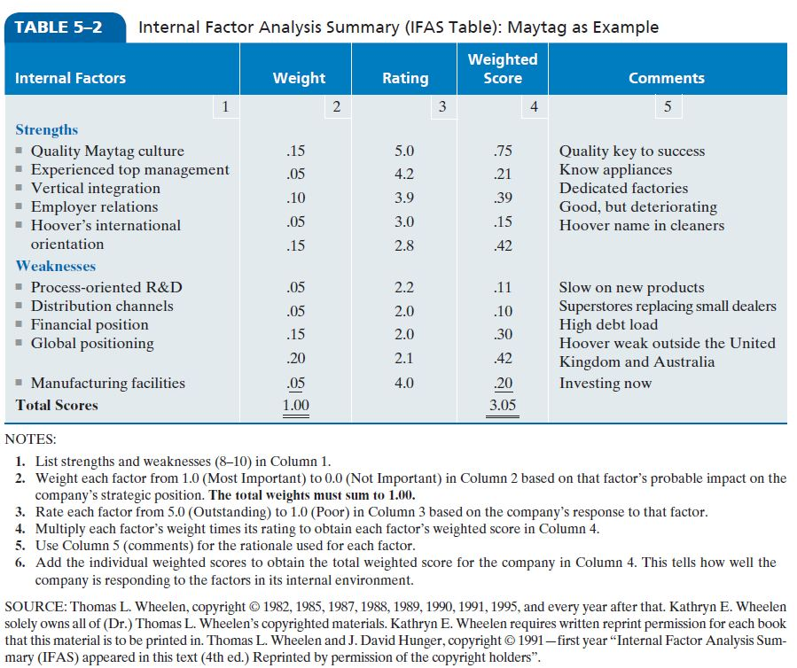
Table 5-2: Synthesis of Internal Factors (IFAS)
Notes:
Use the VRIO framework (Value, Rareness, Imitability, and Organization) to assess the importance of each of the factors that might be considered strengths.

